Slide 1
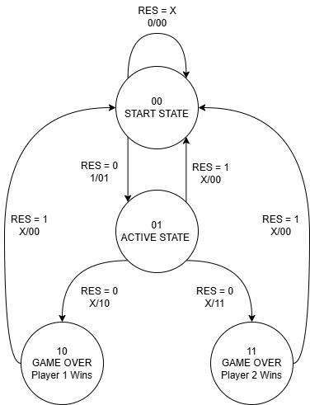
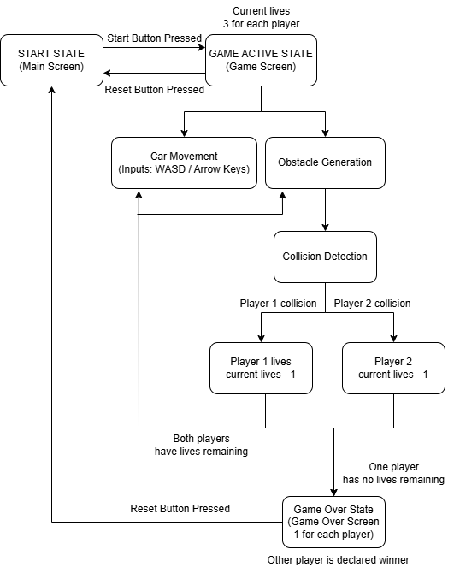
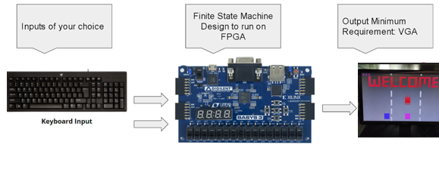
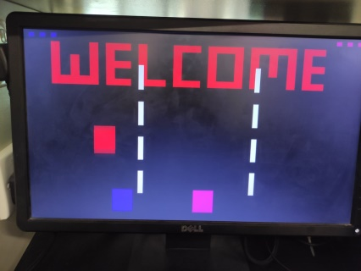
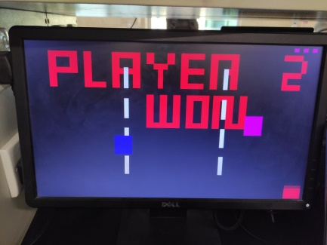
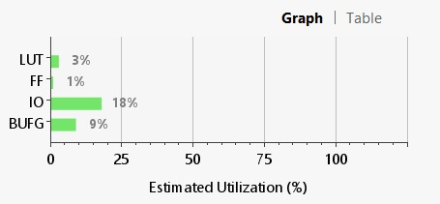
CAR SMASH Abdul Karim, Huzaifa Ali Khan,Sheikh Mohammad Muneeb,Syed Hamza Raza, Muhammad Zoraiz Azeem
Introduction
This project implements a dynamic two-player car racing game using the Basys 3 FPGA board. Players control cars via keyboard inputs (WASD and arrow keys) to avoid randomly generated obstacles. The game uses a Moore Finite State Machine to manage states, and outputs include VGA display for visuals and life tracking.
FSM State Transition Diagram
USER FLOW DIAGRAM
System Diagram
Results
Hardware Resource Utilization

